Slide 1
Module 1
Deploying and Managing Windows Server 2012
Notes:
20410D
1: Deploying and Managing Windows Server 2012

Slide 2
Windows Server 2012 R2 Editions
Windows Server 2012 editions:
Windows Server 2012 R2 Standard
Windows Server 2012 R2 Datacenter
Windows Server 2012 R2 Foundation
Windows Server 2012 R2 Essentials
Microsoft Hyper-V Server 2012 R2
Windows Storage Server 2012 R2 Workgroup
Windows Storage Server 2012 R2 Standard
Windows MultiPoint Server 2012 Standard
Windows MultiPoint Server 2012 Premium
Notes:
20410D
1: Deploying and Managing Windows Server 2012

Slide 3
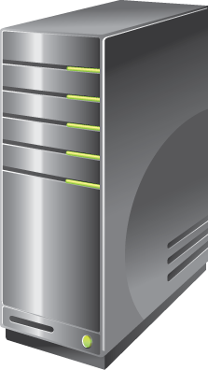
Besoins matériels
Processor architecture x64
Processor speed 1.4 GHz
Memory (RAM) 512 MB
Hard disk drive space 32 GB
Si la RAM est supérieure à 16 GB, l’espace disque minimal doit être supérieur à 32 GB.
Notes:
Remind students that the minimum hardware requirements apply to the operating system itself, and do not include any applications that they might want to deploy on the operating system. Hardware requirements also vary depending on the server role. For example, a SQL Server database server requires a more powerful processor and more RAM than a server that functions as a file server.
Question
Why does a server need more hard disk drive space if it has more than 16 GB of RAM?
Answer
A server needs more hard disk drive space because it requires additional hard disk space for virtual memory.
20410D
1: Deploying and Managing Windows Server 2012

Slide 4
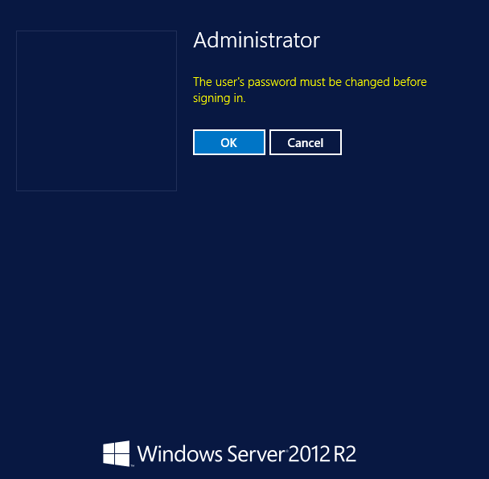
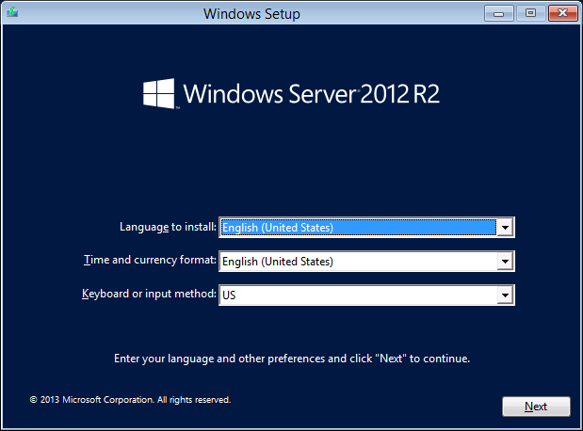
Installation de Windows Server 2012
Notes:
Slide 1 of 7: Choose installation language, currency format, time format, and keyboard input method.
There are seven slides for this topic. None have actual animations.
Use these slides to demonstrate each part of the Windows Server 2012 R2 installation process.
Reinforce that only a few decisions need to be made to deploy Windows Server 2012 R2.
Remind students that in almost all cases they will use the Custom rather than the Upgrade installation option.
Remind students that upgrades must be launched from within the Windows Server operating system, but that they can launch a fresh installation from bootable media.
The seven separate slides illustrate the Windows Server 2012 R2 installation steps:
Slide 1: Choose installation language, currency format, time format, and keyboard input method.
Slide 2: Click Install Now, or choose to repair your computer.
Slide 3: Select the operating system that you want to install.
Slide 4: Review and accept the license terms.
Slide 5: Select the installation type, Upgrade or Custom.
Slide 6: Select the installation location.
Slide 7: Provide the password for the local administrator account.
20410D
1: Deploying and Managing Windows Server 2012

Slide 5
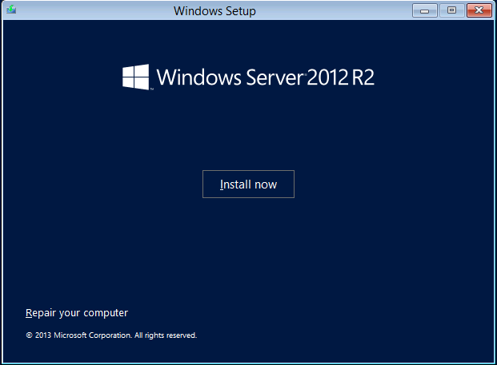
Installation de Windows Server 2012
Notes:
Slide 2 of 7: Click Install Now, or choose to repair your computer.
20410D
1: Deploying and Managing Windows Server 2012

Slide 6
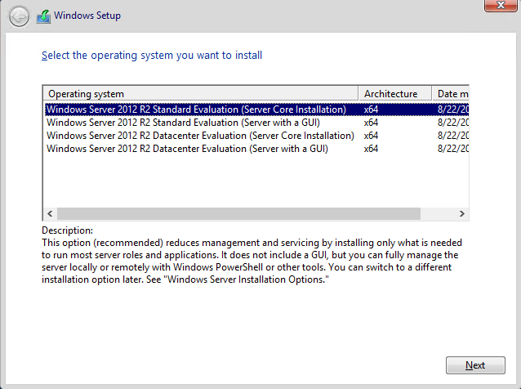
Installation de Windows Server 2012
Notes:
Slide 3 of 7: Select the operating system you want to install.
20410D
1: Deploying and Managing Windows Server 2012

Slide 7
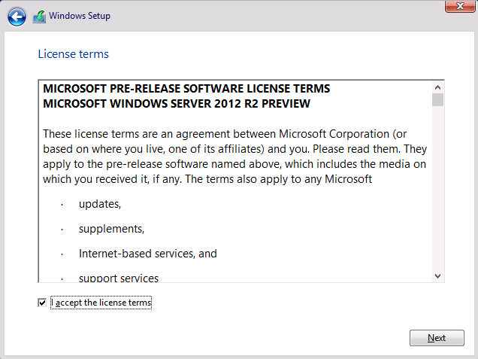
Installation de Windows Server 2012
Notes:
Slide 4 of 7: Review and accept the license terms.
20410D
1: Deploying and Managing Windows Server 2012

Slide 8
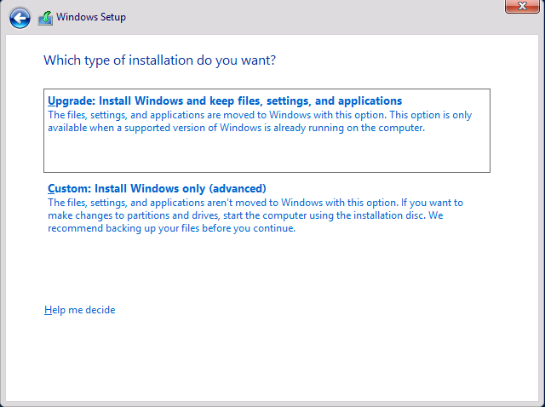
Installation de Windows Server 2012
Notes:
Slide 5 of 7: Select the installation type, Upgrade or Custom.
20410D
1: Deploying and Managing Windows Server 2012

Slide 9
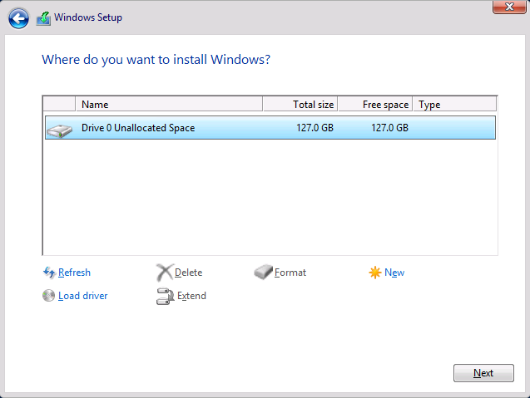
Installation de Windows Server 2012
Notes:
Slide 6 of 7: Select the installation location.
20410D
1: Deploying and Managing Windows Server 2012

Slide 10
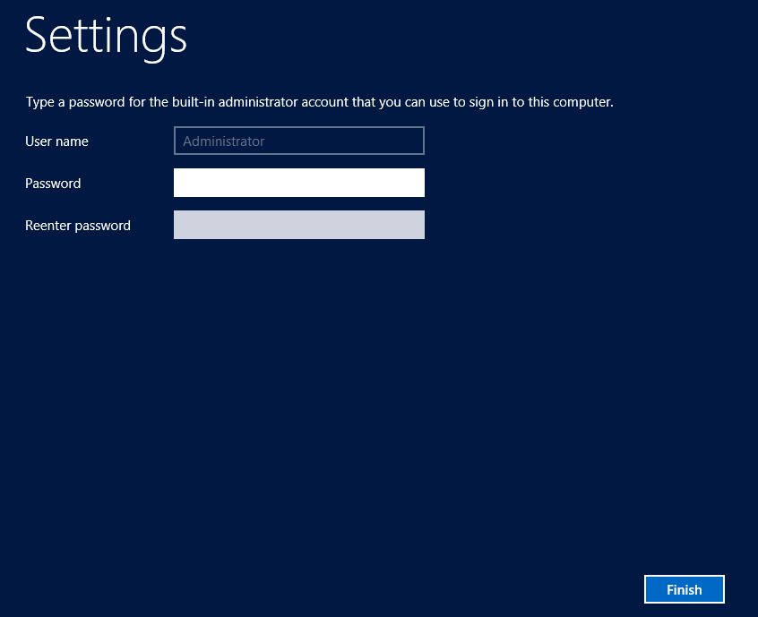
Installation de Windows Server 2012
Notes:
Slide 7 of 7: Provide the password for the local administrator account.
20410D
1: Deploying and Managing Windows Server 2012

Slide 11
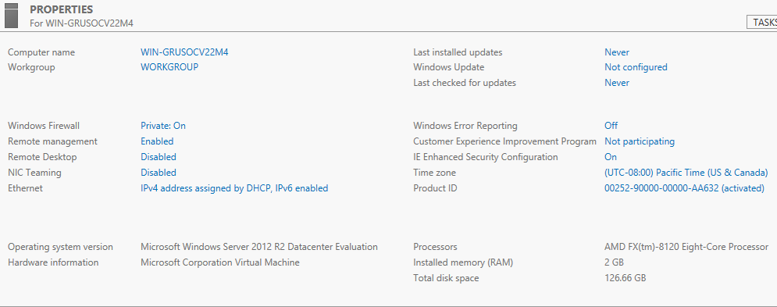
Server Manager > Local Server
Notes:
20410D
1: Deploying and Managing Windows Server 2012

Slide 12
Server Core ?..
Server Core:
Version de Windows Server 2012 plus sécurisée et plus légère ;
Possibilité de passer de la version « Server Core » à la version standard (installation de l’interface graphique) ;
Version par défaut de Windows Server 2012 ;
Pour une gestion locale : « sconfig.cmd » ;
Pour une gestion à distance : « remote management ».
Notes:
20410D
1: Deploying and Managing Windows Server 2012

Slide 13
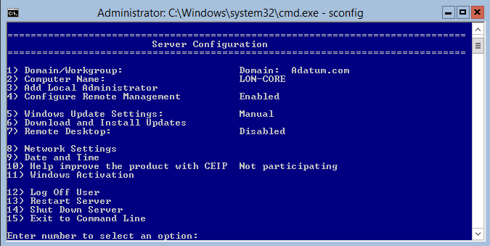
Configuration d’un Server Core
Notes:
20410D
1: Deploying and Managing Windows Server 2012

Slide 14
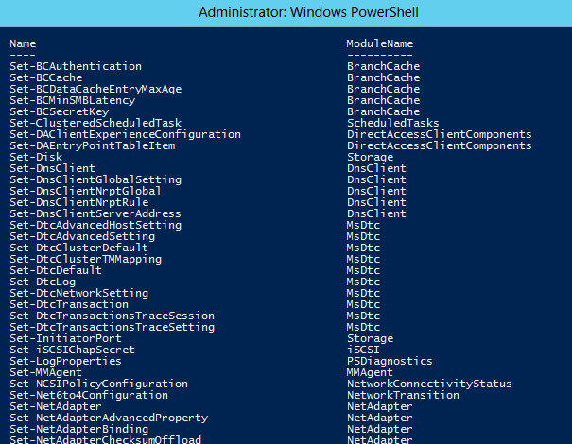
Windows PowerShell
Notes:
20410D
1: Deploying and Managing Windows Server 2012

Slide 15
Windows PowerShell : Syntaxe
Quelques astuces :
Get-Help NounName
Get-Help VerbName
Help CmdltName
Liste des principaux verbes/actions : Get, New, Set, Restart, Resume, Stop, Suspend, Clear, Limit, Remove, Add, Show, Write, …
Notes:
20410D
1: Deploying and Managing Windows Server 2012

Slide 16
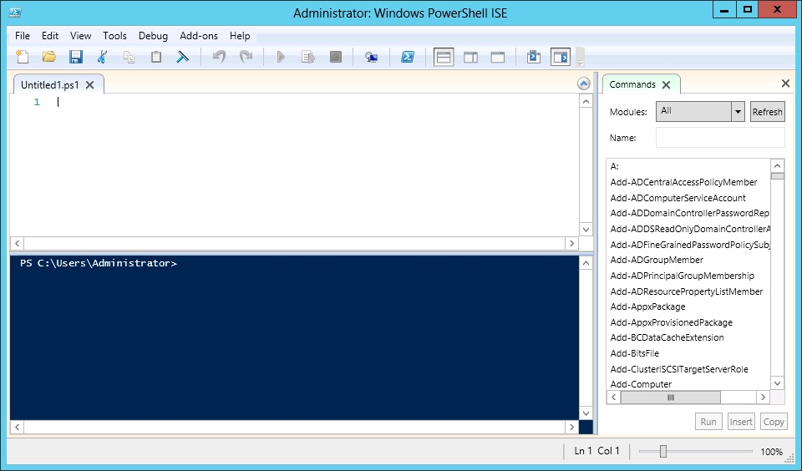
Windows PowerShell ISE
Notes:
Discuss the benefits of using the Windows PowerShell Integrated Scripting Environment (ISE) over using the normal Windows PowerShell window.
20410D
1: Deploying and Managing Windows Server 2012

Slide 17
Lab: Deploying and Managing Windows Server 2012
Exercise 1: Deploying Windows Server 2012 Exercise 2: Configuring Windows Server 2012 Server Core Exercise 3: Managing Servers Exercise 4: Using Windows PowerShell to Manage Servers
Logon Information
Virtual machines 20410D‑LON‑DC1
20410D‑LON‑SVR3
20410D‑LON‑CORE
User name Adatum\Administrator
Password Pa$$w0rd
Estimated Time: 75 minutes
Notes:
Before the students begin the lab, read the lab scenario and display the next slide. Before each exercise, read the scenario associated with the exercise to the class. The scenarios give context to the lab and exercises, and help you facilitate the discussion at the end of the lab. Remind the students to complete the discussion questions after the last lab exercise.
Exercise 1: Deploying Windows Server 2012
The first Windows Server 2012 server that you are installing for the Marketing department will host a SQL Server 2012 database engine instance. You want to configure the server so that it will have the full GUI, as this will allow the application vendor to run support tools directly on the server, rather than requiring a remote connection.
The first server you will install for the new marketing app is for a SQL Server 2012 database. This server will have the full GUI to allow the application vendor to run support tools directly on the server.
Exercise 2: Configuring Windows Server 2012 Server Core
The web‑based tier of the marketing application is a .NET application. To minimize the operating system footprint and reduce the need to apply software updates, you have chosen to host the IIS component on a computer that is running the Server Core installation option of the Windows Server 2012 operating system.
To enable this, you need to configure a computer that is running Windows Server 2012 with the Server Core installation option.
Instructor Note: Advanced students can choose to use appropriate command‑line commands rather than utilizing sconfig.cmd to perform these configuration tasks.
Exercise 3: Managing Servers
After deploying the servers LON‑SVR3 and LON‑CORE for hosting the Marketing application, you need to install appropriate server roles and features to support the application. With this in mind, you will install the Windows Server Backup feature on both LON‑SVR3 and LON‑CORE. You will install the Web Server role on LON‑CORE.
You also need to configure the World Wide Web Publishing service on LON‑CORE.
Exercise 4: Using Windows PowerShell to Manage Servers
The marketing application vendor has indicated that the company can provide some Windows PowerShell scripts to configure the web server that is hosting the application. You need to verify that remote administration is functional before you run the scripts.
20410D
1: Deploying and Managing Windows Server 2012

